Slide 1

Price prediction of used BMW cars

Slide 2
What determines the price of used cars?
Only in the first year, the value of a car can decrease from 10 to 60 percent.
Why the difference in price is so significant?
Brand and model
Year of production
Mileage
Transmission type
Fuel type
Condition of a vehicle
Location
Color, etc.

Slide 3
The goals of the project
Explore what factors affect a sale price of used BMW cars
Build a prototype of model which predicts price of used BMW cars.
The results of this project may be useful to:
Optimize evaluation process of used cars
Save time efforts to get a rough price estimation
Automatic search for the best deals

Slide 4
The dataset
The dataset was obtained from DataCamp GitHub repository.
Source is unknown, but based on data parameters it’s likely the data describes BMW cars sales in UK market.
There are 10781 observations and 9 columns:
3 categorical parameters: model, transmission, fuelType.
5 numerical parameters: year, engineSize, mileage, tax, mpg.
Target parameter that we want to predict - price.
Statistics of UK passenger cars market
About 6.75 millions of used cars were sold in 2020 in UK - a decline of 14.9% year-on-year (SMMT, 2020)
115.5K of new BMW passenger cars were sold in 2020 in UK - a decline of 32 % year-on-year (Statista, 2020)
The main reason stated for choosing used cars over new cars from buyers was ‘the better affordability of used cars in comparison with new ones’ (Statista, 2020)
Car buyers gave ‘the right car at the right price’ as one of the most important factors when deciding to buy from a particular dealer. (Statista, 2020)

Slide 5
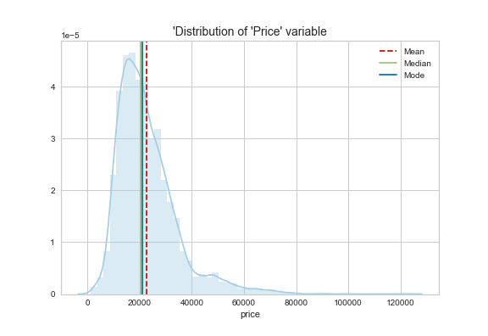
The dataset overview. Range of prices
Average price – 22 723 £

Slide 6
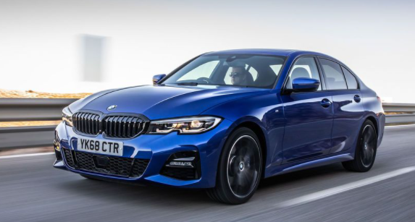
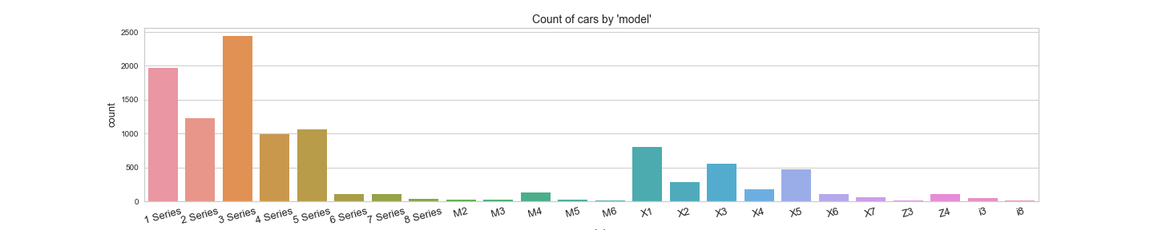
The dataset overview. BMW cars Models
BMW 3 Series is the most popular car
Naming conventions for BMW models:
Number in model name refers to vehicle size.
Series with odd numbers (1, 3, 5 and 7) are sedan-style and with even numbers (2, 4, 6 and 8) are coupe-style vehicles .

Slide 7
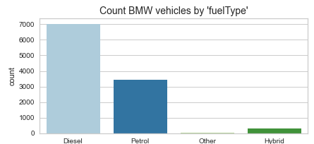
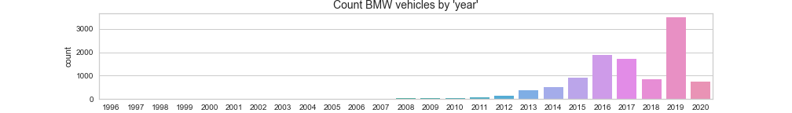
The dataset overview. Fuel Type and Year

Slide 8
Which car characteristics determine a price?
Analysis performed:
Analyze correlation of car parameter values with price.
1-way ANOVA test for categorical parameters to define if there is a statistically significant difference in price for different groups.
Analyze score of importance calculated by predictive model.
Following parameters explain about 96% of variance in price:
Year
Mileage
Model group (especially model group X sub-category affect the price)
Number in model name
Miles per gallon
Engine size
Transmission type (Manual or Automatic/Semi-automatic)
Fuel type

Slide 9
Prototype of used BMW cars price predictor
Steps of prototype implementation:
Clean and validate the data
Make transformations and preprocess the data for modeling
20% of the dataset was separated to test accuracy of predictions
Test algorithms and choose the best one
Check achieved results by calculating performance metrics
Explained variance of price
Mean Absolute Error
Root Mean Squared Error
Tune the predictive model

Slide 10
Prototype of used BMW cars price predictor
The best results were achieved with CatBoost regression algorithm:
96.31% of variance in price is explained by input parameters.
Average error of price predictions is £1436.
About 80% of predictions have error in predicted price 10% or less.
Almost 8% of predictions have error more than 15%.

Slide 11
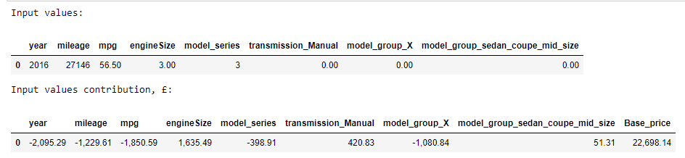
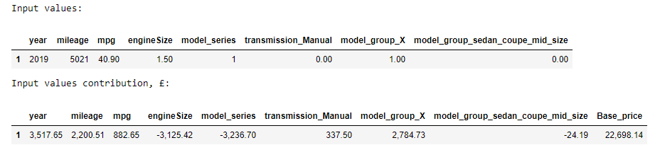
We can see how each characteristic affect the price
Example 1:
Example 2:

Slide 12
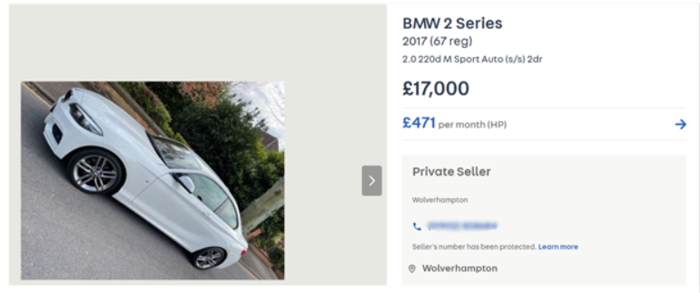
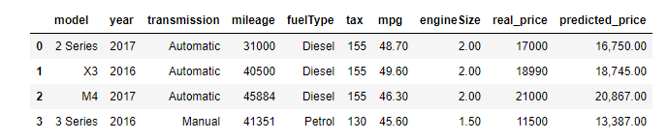
Price prediction on real examples from www.autotrader.co.uk deals
Results on the 4 samples of real deals:
93.4% of variance in price is explained by input parameters
Average error in predictions is about 629 £

Slide 13
Conclusions and Recommendations
Limitations of the price prediction model:
Define business requirements for the model performance.
Chosen algorithm (CatBoostRegressor) is relatively computationally expensive.
Cars sales data quickly gets irrelevant with time. The price predictor should be updated regularly to provide relevant predictions.
It’s necessary to validate the input data car characteristics as it may contain mistakes due to human or technical factor.

Slide 14
Conclusions and Recommendations
Possible ways to improve performance of the model:
Tune the predictive model prototype.
Collect more information about car characteristics.
Collect more data (older cars and specific model groups).
Explore model performance on the real unseen data and tune it.

Slide 15
Thank you ☺

